Slide 1
Bibliometric Analysis of Research Publications in Domain of Computer Science : Case Study of Pakistani Authors
Hamza Munir MSDS20061
Agha Muhammad Anas MSDS20068
Mehmood Ali MSDS20090
Bibliometric Analysis is the study of analyzing the scientific research patterns and trends in specific community, country and field etc

Slide 2
Objective
Purpose is to take a general look at the different approaches adopted by different researchers.
Our investigations are focused on the publication trends in Computer Science journal publications.

Slide 3
Process / Challenges:
Gathering and Collection of Data
Cleaning and Pre-processing of the data
Understand user behavior using different features available in dataset
Then apply machine learning model for classification and clustering of user

Slide 4
Data Collection:
Data is collected from Web of Knowledge also known as Web of Science, Clarivate Analytics.
Using advanced search from Web of Knowledge website, data is queried using following input parameter from Web of Knowledge.
Query CU=(PAKISTAN) AND SU=(Computer Science) Indexes = SCI-EXPANDED, SSCI, A&HCI, ESCI Timespan = (All years)
In our query, CU acts as Country/Region, SU as Research Area, SCI_EXPANDED as Science Citation Index Expanded, SSCI as Social Science Citation Index, A&HCI as Arts & Humanities Citation Index, ESCI as Emerging Sources Citation Index.

Slide 5
Data Collection:
Query returned a total of 8,843 publications with publications in English with a few exceptions in other languages.
The results were extracted and stored in the form of Text(.txt) format file.
The data was downloaded on 18th December 2020.
The data-set contains 8843 rows, each row represents single publication and 60 columns representing different information about publications.

Slide 6
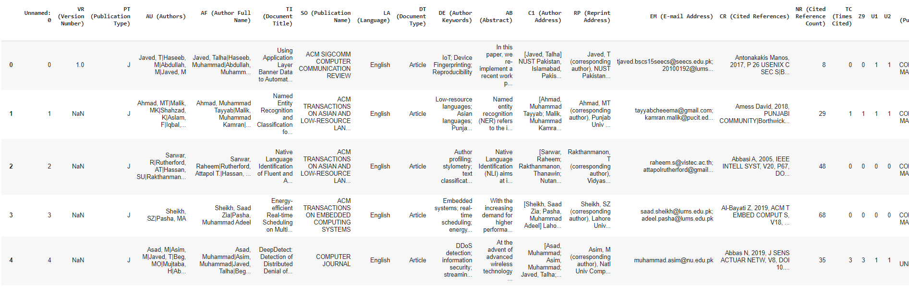
DataSet:

Slide 7
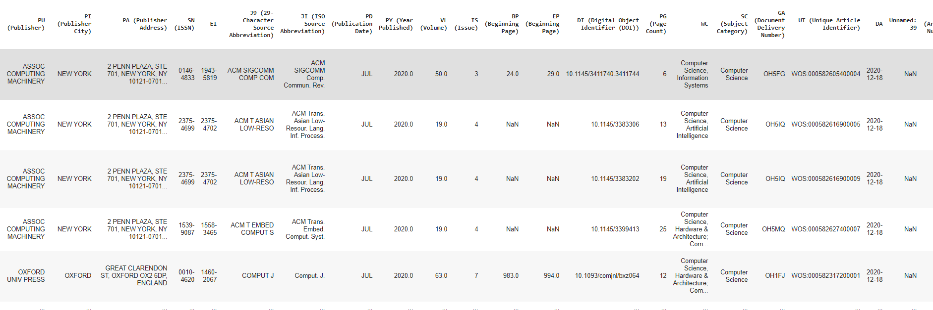
DataSet:

Slide 8
Tools:
Python programming language
Jupyter Notebook and Colab
Data Analysis with libraries such as numpy, matplotlib, seaborn, pandas etc.
In parallel, we have also used R language in R studio with libraries Bibliometrix and Biblioshiny to get advance level visualizations.

Slide 9
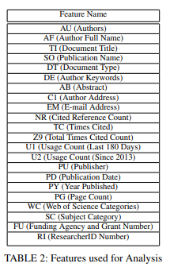
Data Pre-Processing and Feature Selection:
Dataset was mined in 18 plain text (.txt) format files.
We used online tools to convert the text data files into Comma Separated values (CSV) format.
Using Pandas tool and Comma Separated values (CSV) files we merged these files and made 1 dataframe.
After analysis of our dataset we identified important and unimportant features which can be useful for our analysis and research.
We were left with 22 columns after dropping non important columns to perform the analysis.

Slide 10
Research Questions:
Asking these research questions will form the basis of our research and help us to extract fruitful insights.
1) What is the trend of Computer Science publications and citations?
2) Which research areas have more Computer Science research based on the number of publications?
3) What are the most influential papers in Computer Science domain according to the number of citations?
4) What are the most popular publication venues for Computer Science related papers?
5) What are the top most supportive funding agencies of Computer Science papers?
6) What is the future research direction in the Computer Science domain?
7) Determine the top cited publications?
8) Determine how Pakistani researcher are collaborating with other countries?
9) Determine which publications were top for each year?
10) Determine how many publications have recorded maximum citations throughout?
11) Determine average citations per Publication?
12) Determine the publications where Number of Authors are one and greater?
13) Determine average number of authors per publications?

Slide 11
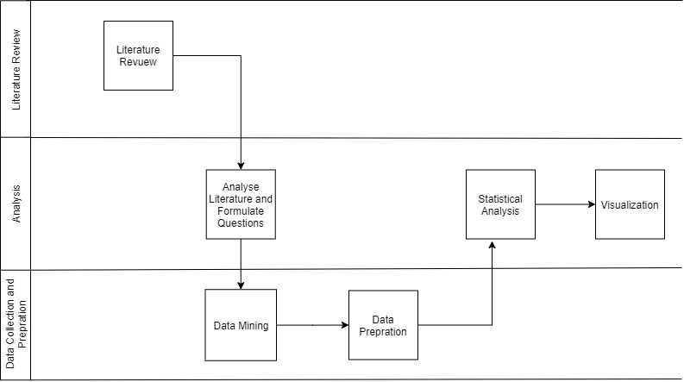
METHODOLOGY

Slide 12
METHODOLOGY
To measure the impact of research published, we used several bibliometric indicators
META-BASED ANALYSIS:
Count Of Publications (P) per Author : Author published how many number of Articles.
Count Of Publications (P) per Country : Country contributed in publishing how many number of Articles.
Count Of References per article : Article used how many number of references.
2. CONTENT-BASED ANALYSIS Word Cloud :
Most frequent word used in Document Abstract, Author Keywords and Document Title

Slide 13
METHODOLOGY
3. CITATION-BASED ANALYSIS :
Average Citation per Year : What is the average citations per year.
Average Citation per Author : Total Number of Citations present against a Keyword.
4. SOCIAL NETWORK ANALYSIS :
is used when we cannot observe relationship or dig out much information through statistical analysis.Social network analyses are useful in finding hidden details and communities within data.

Slide 14
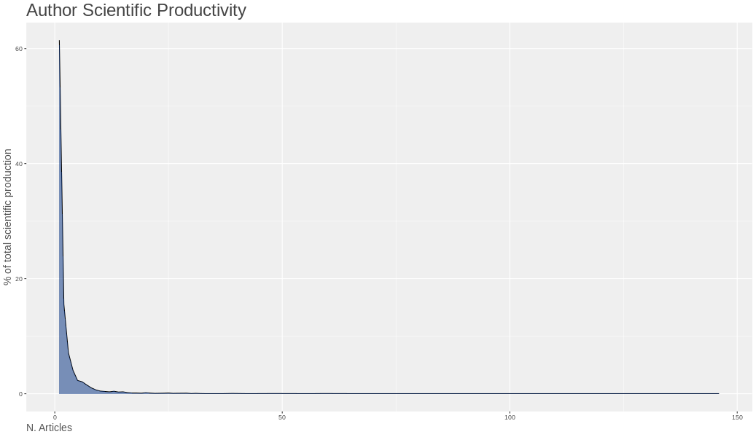
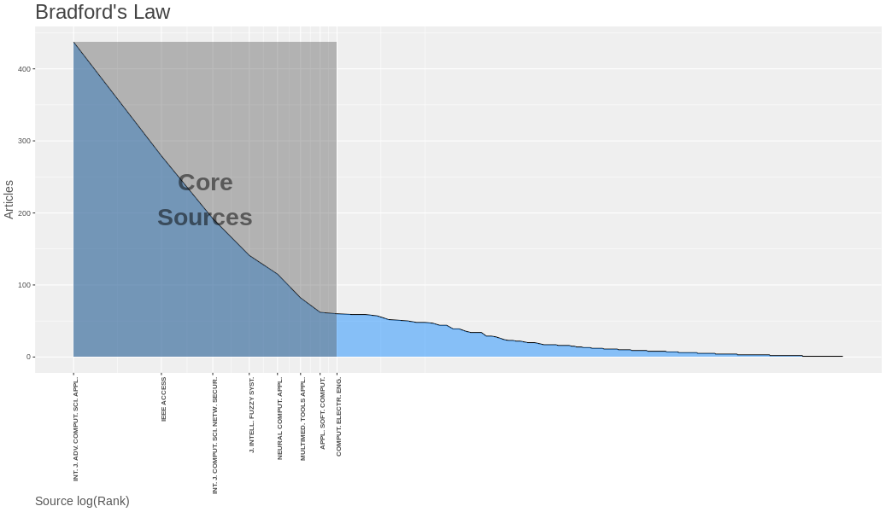
METHODOLOGY
5. LOTKA’S LAW:
Lotka’s law is a discrete probability distribution function that tells the author productivity within that domain. Lotka’s Law describes the frequency of publication by authors in each field.
6. BRADFORD’S LAW:
Bradford’s Law serves as a general guideline to librarians in determining the number of core journals in any given field.

Slide 15
Results:
Analysis and findings about the Computer Science publications by Pakistani Authors are presented.
Citation based analysis is performed to analyse the impact of research.
Publication based analysis is performed to analyze the top publications.
Different types of Content based analysis is also performed for better understanding of research patterns.
The Impact of Different journals, Publishers and Funding Organization is also analyzed

Slide 16
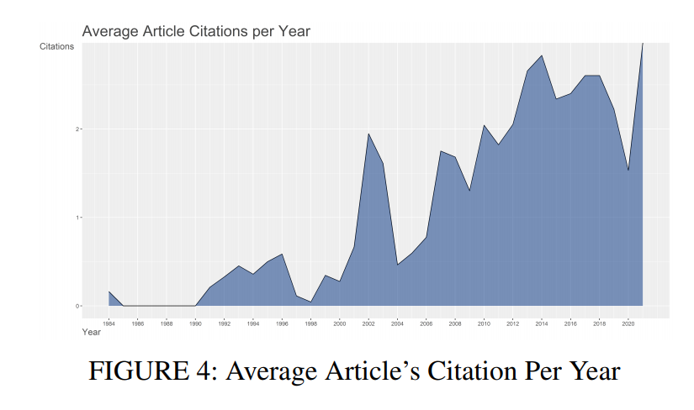
Results:
CITATION ANALYSIS
Average Article Citation per
Year

Slide 17
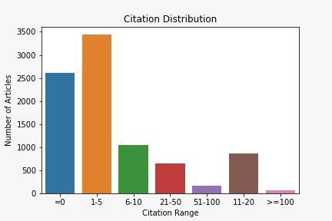
Results:
2. Citation Distribution:
Around 38 percent of the documents only got citations from 1-5.
The most alarming thing is the 28 percent of the documents didn’t get any citation.
Only 3 percent of the documents got more than 50 citations

Slide 18
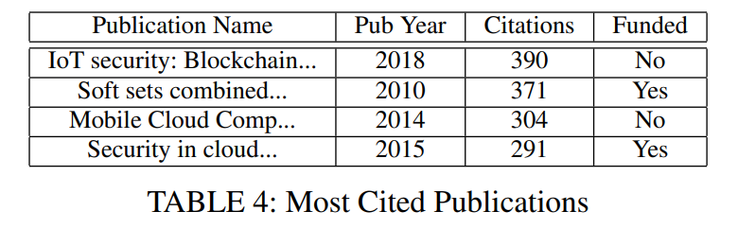
Results:
3. Most-Cited Articles:
Leading publication in the list is published in 2018 by Khan, Minhaj Ahmad|Salah, Khaled in the Web of Science category Computer Science, Theory & Methods. The research focus in this paper is about IoT security, Block-chain and IoT protocols.
The other leading research publications are from the cloud Computing, Wireless sensor networks and Artificial Intelligence.
Whereas in detailed research we found the papers published in 2020 has got the maximum total citation are 64.
It is also observed that the top articles published in 2020 are focused on medical which we can relate with global pandemic due to COVID-19.

Slide 19
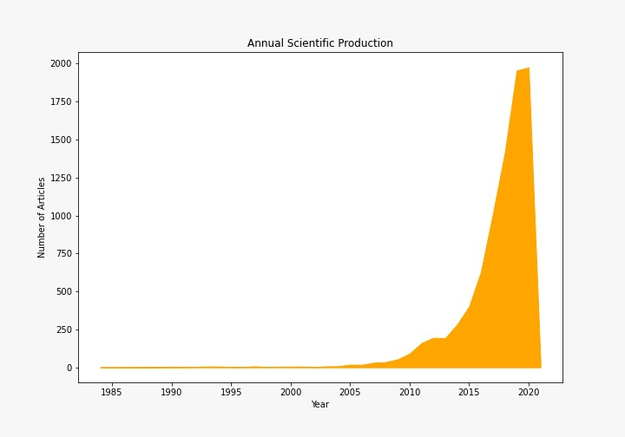
Results: 4. Annual Scientific Production:

Slide 20
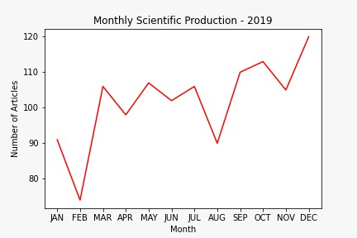
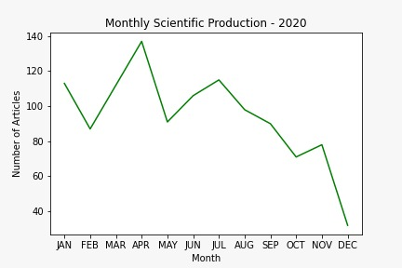
Results: 5. Monthly Scientific Production(2019 and 2020):

Slide 21
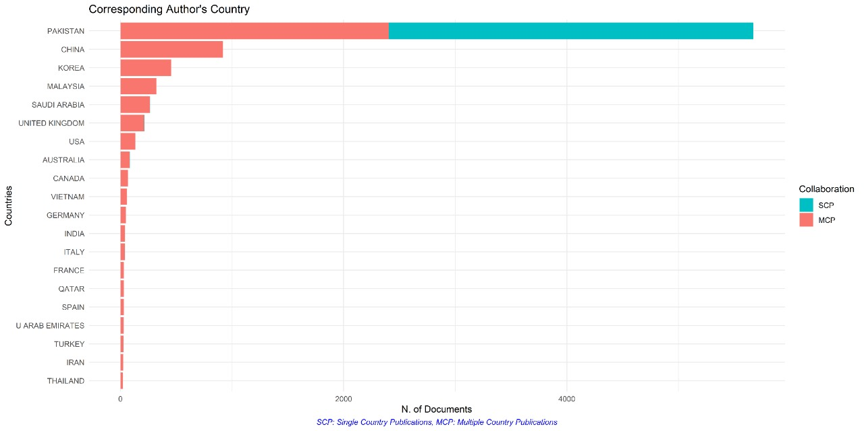
Results: 6. Author Corresponding Country:
Analysis on International Collaboration by counting number of articles published by authors within the same country and papers with authors from different countries. In other words, there are two types of articles: single country publications (SCP) in which all authors belong to the same country and such publications represent intra-country collaboration; and multiple country publications (MCP)

Slide 22
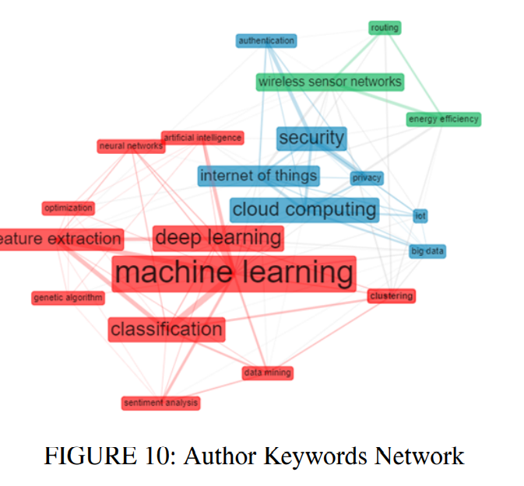
Results: 7. NETWORK GRAPH ANALYSIS:
The co-occurrence network graph is used to extract the semantic relation between the author keywords. The keyword co-occurrence helps researchers to find the publication venues most common topics. These analyses also help researchers to find domains that are strongly related to each other.
The biggest node is machine learning in red color cluster and its closest neighbors are deep learning, feature extractions and classification.
In second cluster (blue) biggest node is cloud computing and its closest neighbor are internet of things, big data and security.
In third cluster (green) wireless sensor network, energy efficiency and routing are neighbors.

Slide 23
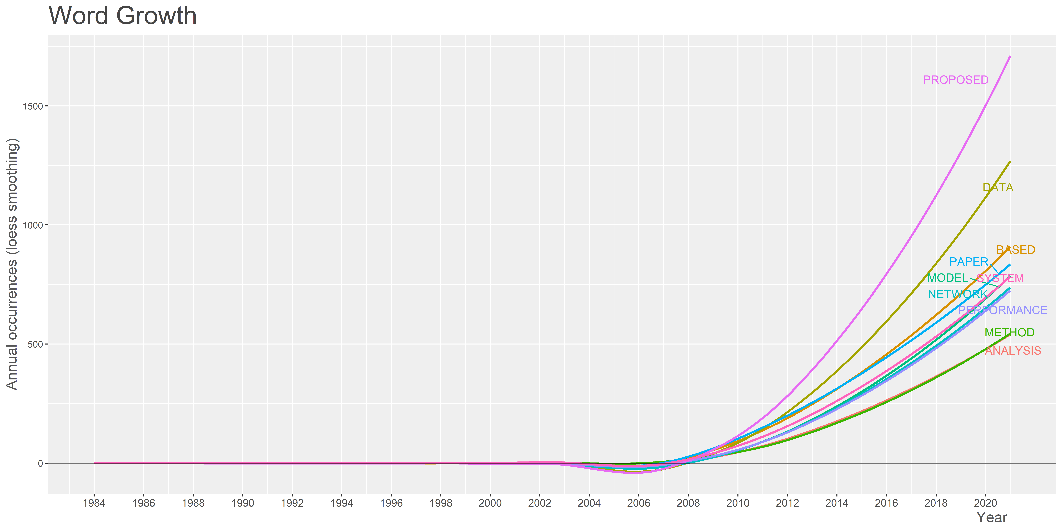
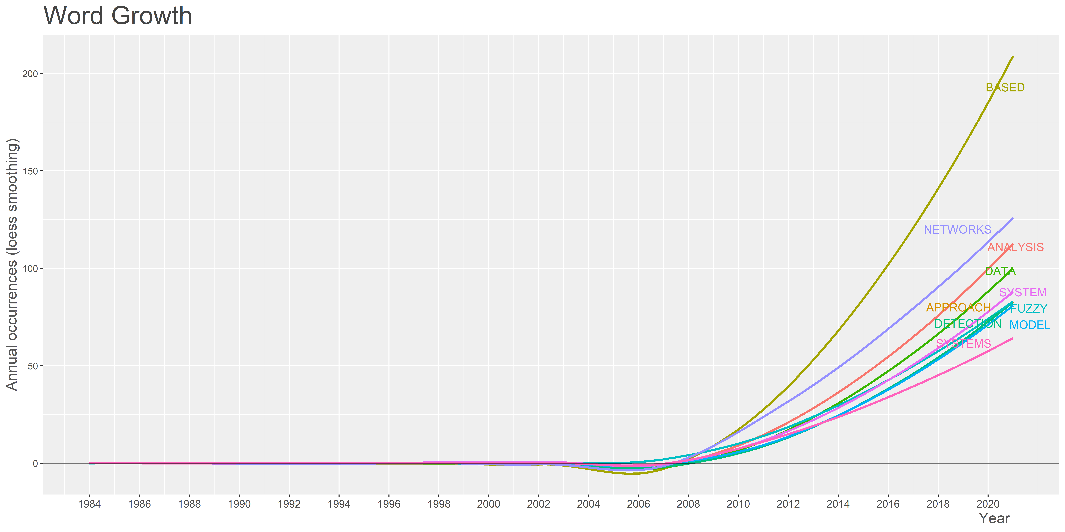
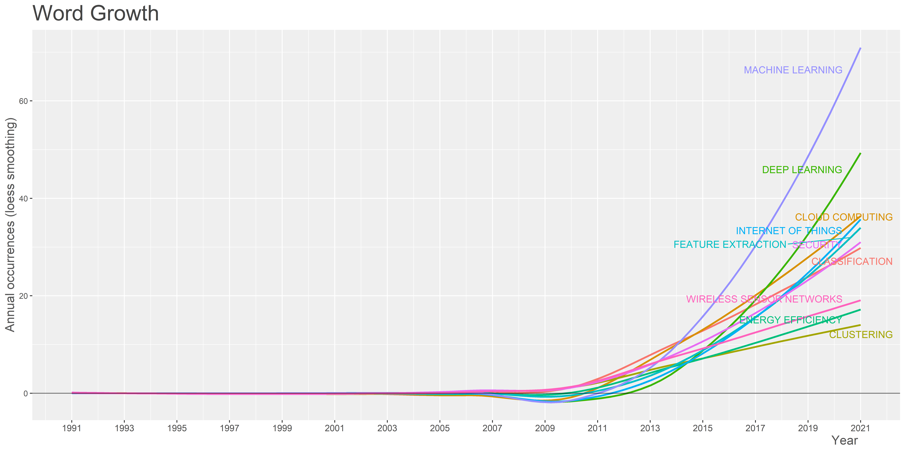
Results: 8. Keyword Growth:
• Keywords Represent the content of the paper.
• Keywords are specific to the field or sub-field

Slide 24
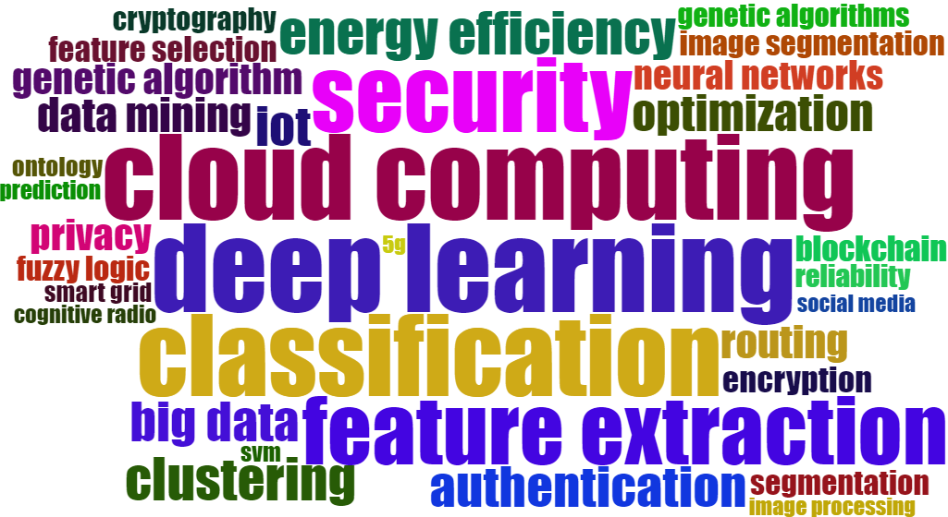
Results: 9. Word-Cloud Analysis:
Author Keywords WordCloud
Use of word cloud for papers in field of computer science is that to analyze the most predominant words which represents most of the work is in those areas.
Deep learning, cloud computing, classification and feature extraction are the most relevant topics. Security, image processing, big data and clustering are also in the list.

Slide 25
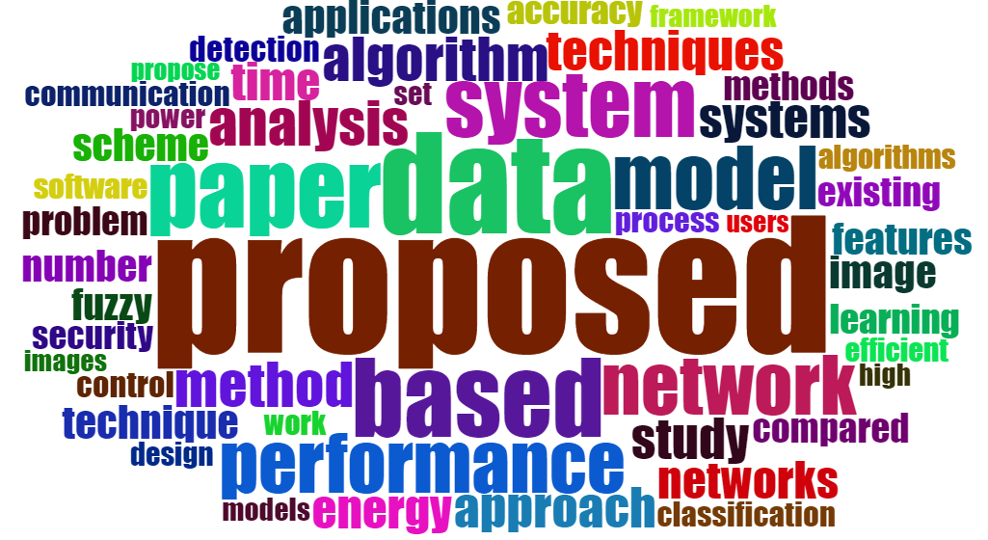
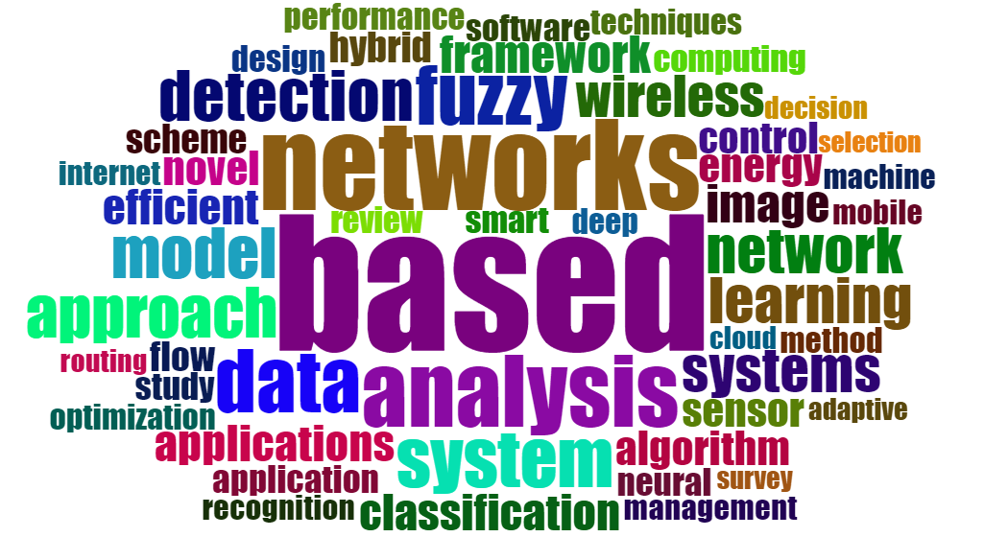
Title WordCloud
Abstract WordCloud

Slide 26
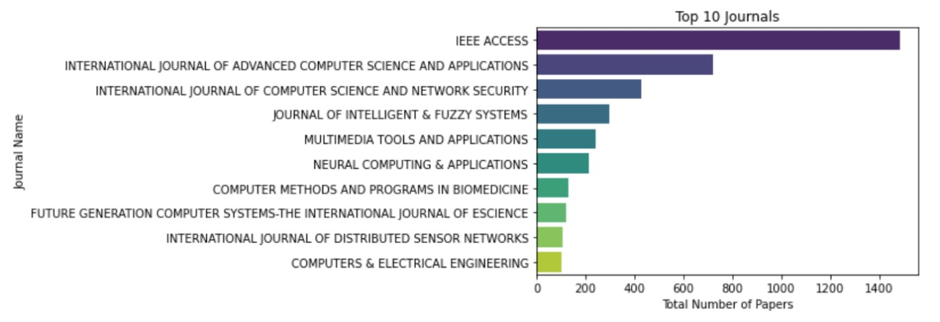
10. TOP JOURNALS

Slide 27
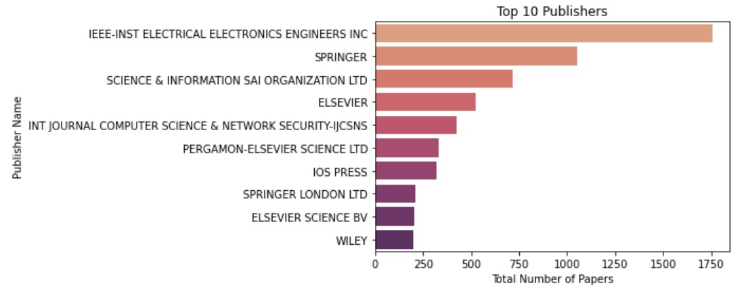
11. Top Publishers:

Slide 28
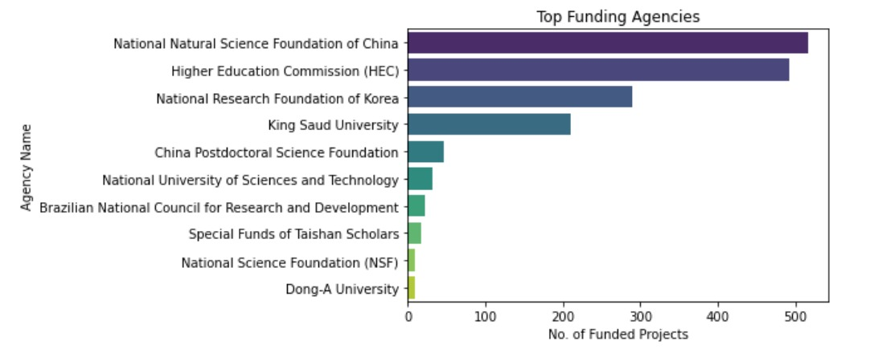
12. Top Funding Organizations:

Slide 29
13. Author Production Over-Time:

Slide 30
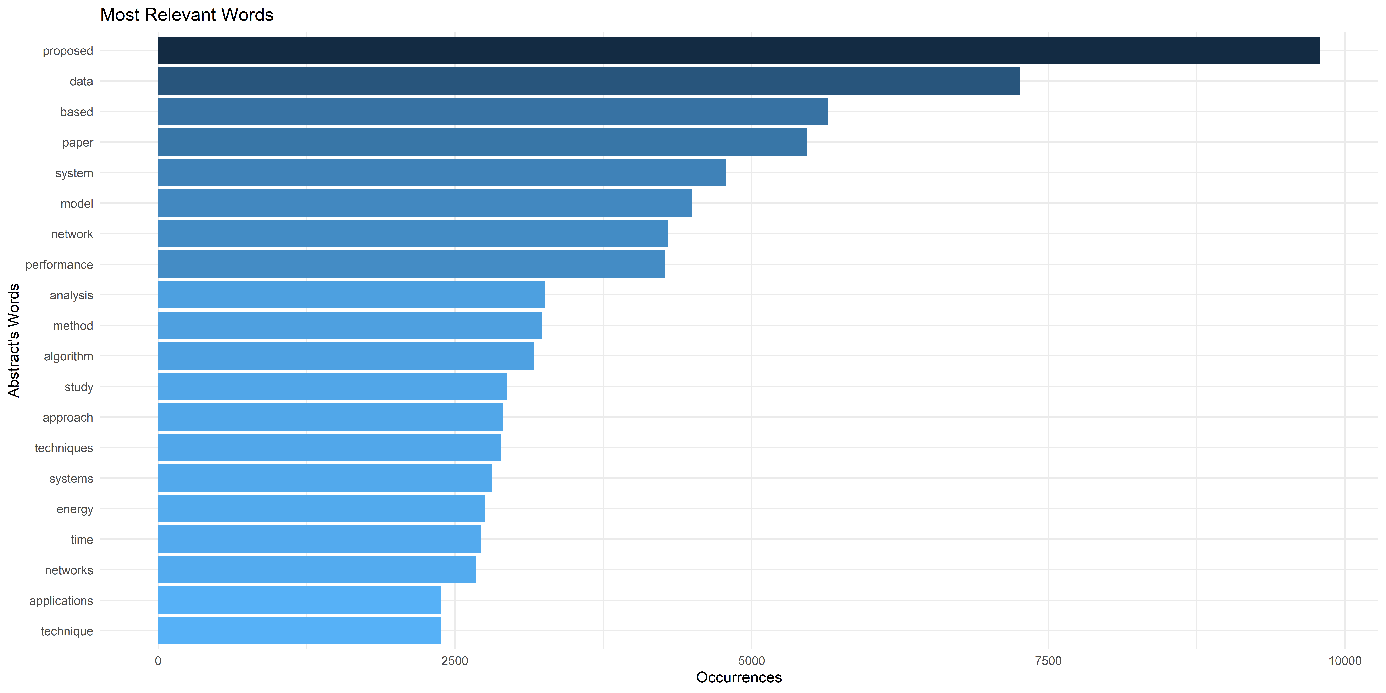
14. Most Frequent Abstract Words:

Slide 31
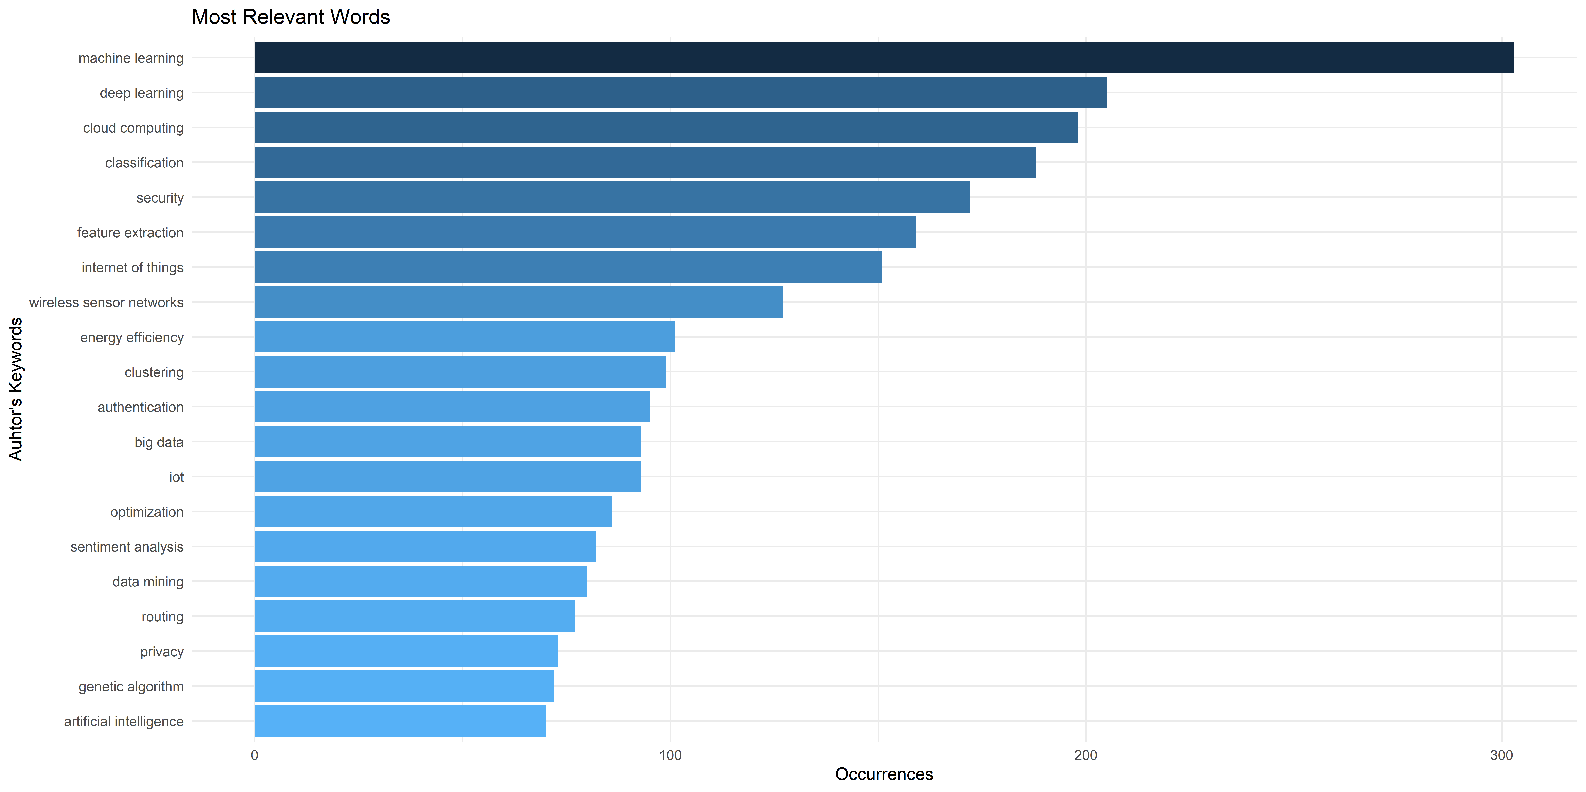
15. Most Frequent Author KeyWords:

Slide 32
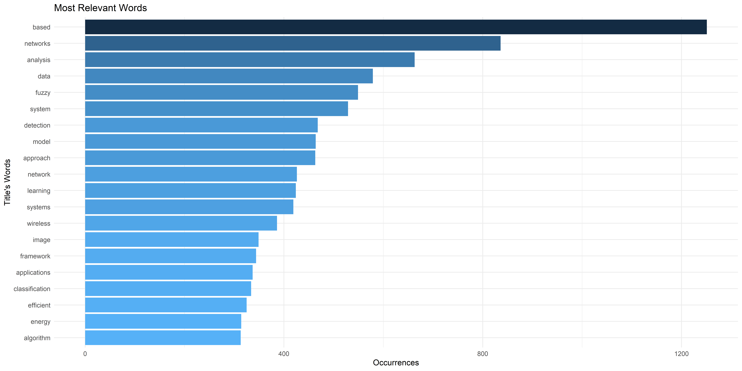
16. Most Frequent Title Words:

Slide 33
Conclusion:

